Slide 1

Welcome to our report

Slide 2
University of Danang
University of Technology
Information Technology Faculty
Flash Disk Storage
Group’s member:
Lê Sữa 08T1 – Designer
Trịnh Duy Nhân 08T1 – Leader
Trần Công Hòa 08T1 – Translator
Nguyễn Thị Kim Hương 08T4 - Speaker
Danang, Feb 2010

Slide 3

What is Flash disk ???

Slide 4
I
N
T
R
O
D
U
C
T
I
O
N
1.
Definition
Structure
Common flash disk
Adventage
Disdventage

Slide 5
Definition
To investigate the performance of linking sounds by the second-year students of English department to help students to form the habit of performing linking sounds in connected speech
Flash memory is a non-volatile computer storage that can be electrically erased and reprogrammed. It is a technology that is primarily used in memory cards and USB flash drives for general storage and transfer of data between computers and other digital products. It is a specific type of EEPROM (Electrically Erasable Programmable Read-Only Memory) that is erased and programmed in large blocks; in early flash the entire chip had to be erased at once

Slide 6
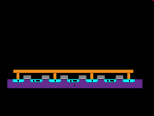
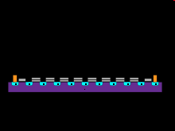
Structure
Use explosion-gate transistors to save information, there are two main types of flash: nand flash and nor flash
Nand flash: actions like a NAND gate
Nor flash: actions like a NOR gate
Nor flash memory wiring and structure on silicon
NAND flash memory wiring and structure on silicon

Slide 7
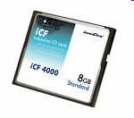


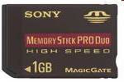

Common flash disks
Compact Flash
USB flash
Multimedia Card
Memory Stick
Mini SD card

Slide 8
Advantage
Flash memory costs far less than another device storage.
It’s smaller, easy to use, easy to replace when damaged and convenient
Not lose data when power is lost

Slide 9
Disadvantage
Limited number of write and read data
Write speed of flash data disk is low
Flash memory must be completely removed a block of information before storage new data

Slide 10
Thank you for litsenning !!

